Slide 1
Measuring priming with motion capture
Khen Heller
Notes:
My experiment’s goal is to show that semantic priming can be measured with motion capture.

Slide 2
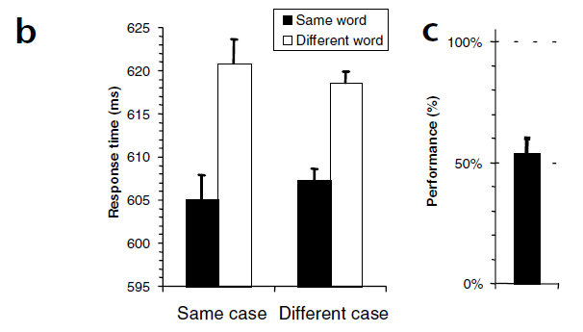
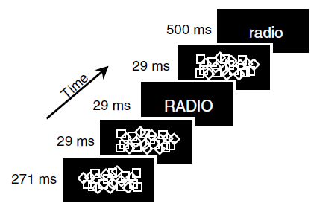
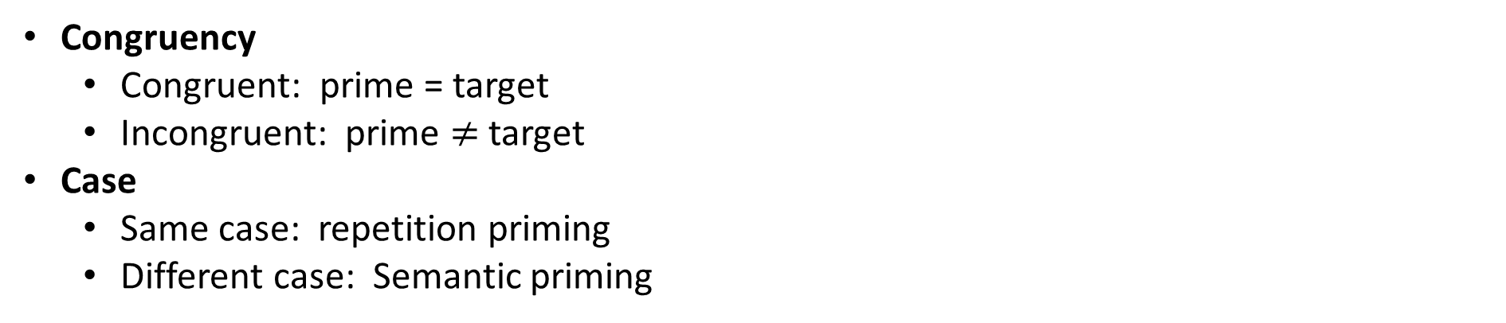
Dehane et al., 2001
Congruency
Congruent: prime = target
Incongruent: prime $≠$ target
Case
Same case: repetition priming
Different case: Semantic priming
Forced choice
Dehaene et al., (2001). Cerebral mechanisms of word masking and unconscious repetition priming. Nature neuroscience, 4(7), 752-758.
Notes:
It is based on Dehaene’s experiment from 2001.
He used forward and backward masking to render a prime invisible. After which he displayed a target.
Subjects were asked to categorize target as natural / artificial. So for example radio is artificial while fruit is natural.
Prime and target could be congruent (identical), or incongruent (from a different category, e.g., fruit).
In addition, letter case was manipulated.
This allowed to check repetition priming (both are the same case),
And semantic priming (each is different case).
At the end of the experiments subjects performed a force choice recognition task: in which they had to recognize the prime between 2 displayed words.
Forced choice showed that subjects weren’t aware of the prime. In task 1 they a naming task (name prime, if didn’t see specifically what is it, say “seen”)
Dehaene showed both a repetition priming effect (15ms) and a semantic priming effect (12ms).
N = 10
40 stimuli words, half nat half art.
Forced choice after priming.
In exp 1:
They ran recognition trials before and after imaging but not during. Same for exp 2.
Subjects need to recognize the prime, if saw only something they say “seen”

Slide 3
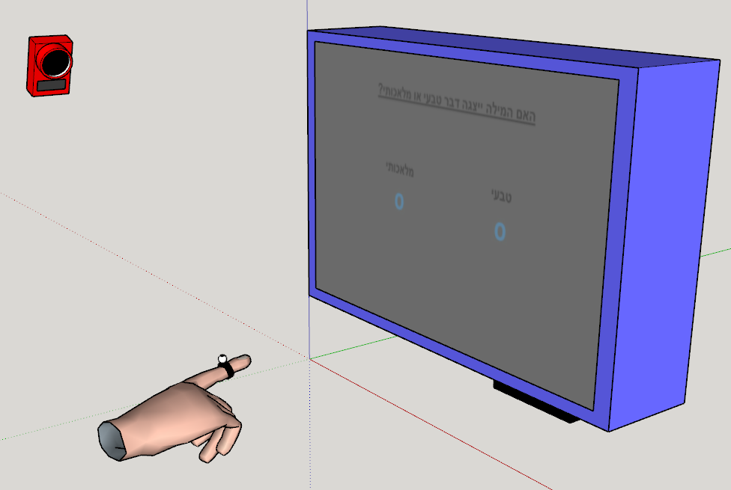
Prime-target relation: Same word
Fixation 1000ms
Mask 270ms
Mask 30ms
RADIO
Prime 30ms
Mask 30ms
Time
radio
Target 500ms
Man-made Natural
Categorization
RADIO PHONE
Recognition
How well did you see the first stimuli?
On a scale of 1-4
PAS
1 2 3 4
Notes:
In our experiment we wish to replicate these results using motion capture.
Again we display the set if masks, prime and target and the subject is asked to categorize the target,
Only this time he does so by touching the appropriate answer on the screen.
Immediately after, the subject performs forced choice recognition where he has to recognize the prime between two words.
Lastly the subject answers a PAS.
Instead of using capital / lower case letters, we use Hebrew handwriting / typescript font.
In contrast to Dehanee, we don’t manipulate this parameter, so all primes are handwriting and all targets are typescript.
This experiment shows lexical activation? Not semantic.

Slide 4
Prime-target relation: Different word
Fixation 1000ms
Mask 270ms
Mask 30ms
CLOUD
Prime 30ms
Mask 30ms
Time
radio
Target 500ms
Man-made Natural
Categorization
CLOUD TIGER
Recognition
How well did you see the first stimuli?
On a scale of 1-4
PAS
1 2 3 4
Notes:
This experiment shows lexical activation? Not semantic.

Slide 5
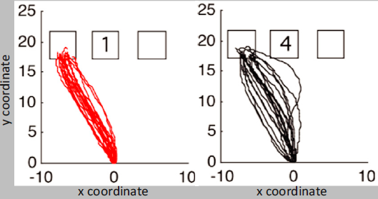
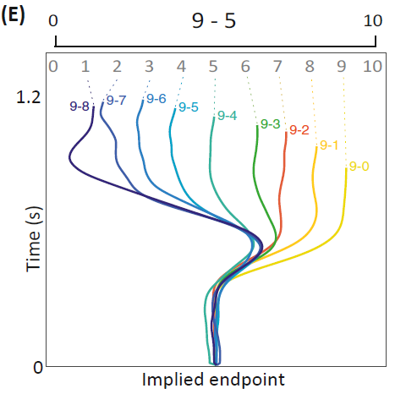
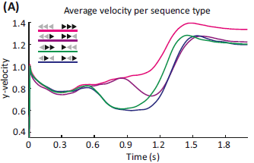
Wished results
Trajectory variance
Implied endpoint
Movement speed – measure confidence in answer
T-test between same points in time
Dotan, D., Pinheiro-Chagas, P., Al Roumi, F., & Dehaene, S. (2019). Track it to crack it: Dissecting processing stages with finger tracking. Trends in cognitive sciences, 23(12), 1058-1070.

Slide 6
Setup

Slide 7
Current work
Coded the experiment.
Integrated motion capture to experiment.
Written testing scripts.
Ran photodiode tests.
Open question: timings.

